Slide 1
Bcc RFID User Guide
2019-10-09
Shenzhen city

Slide 2
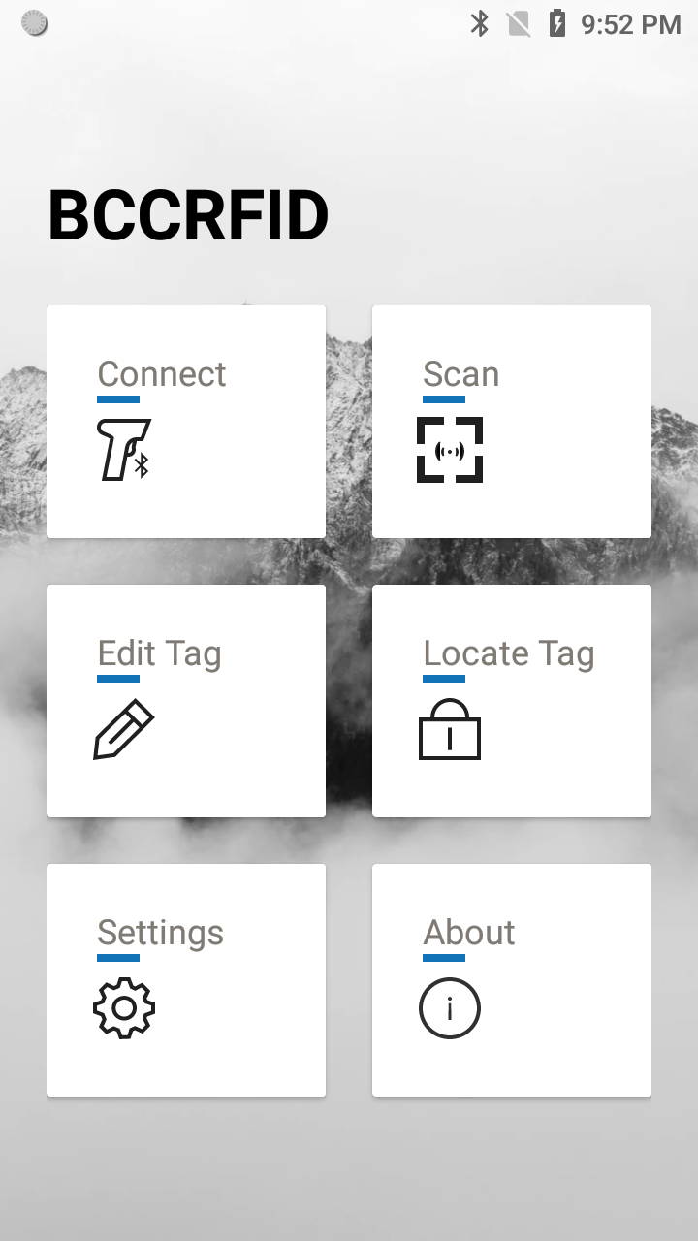
Brief Introduction
BccRFID Main Function:
Bluetooth Auto Connection
Scan
Edit Tag
Locate Tag
RFID/Engine scan switching

Slide 3
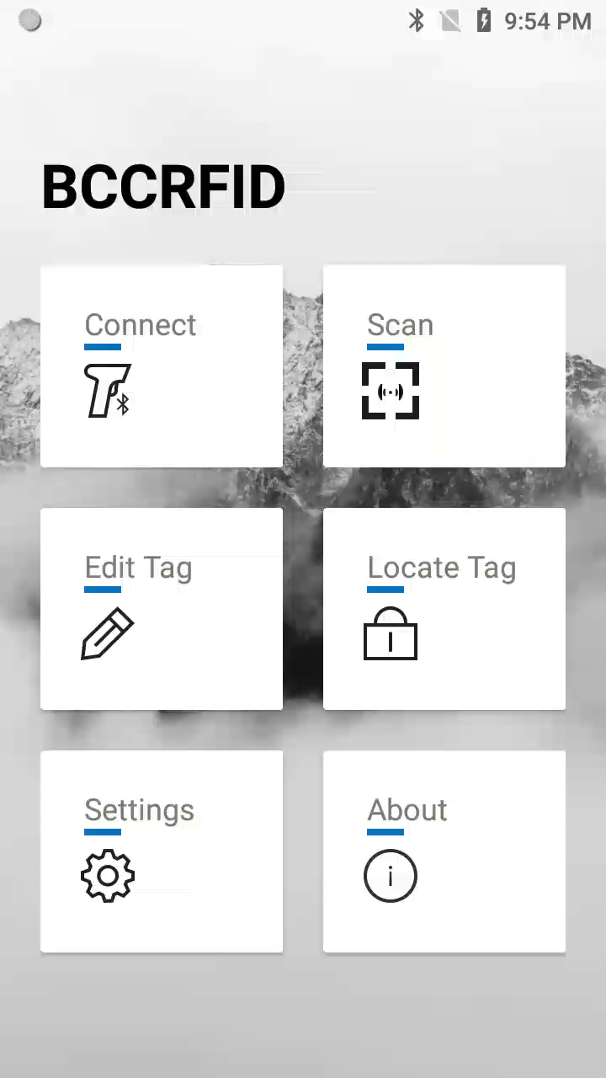
Bluetooth Auto Connection
Reference video
Steps:
1.Go to Connect Page
2.Turn on Auto Connection Switch
3.Click Search Button
After discovering Bluetooth devices for 3 seconds.
PDA will auto connect the nearest Bluetooth device.
Benefits & Value
The traditional way to connect a BLE device will cost more than 8 seconds and several manual operations, this optimized way will only cost less than 4 seconds and user needn’t to do more operations.

Slide 4
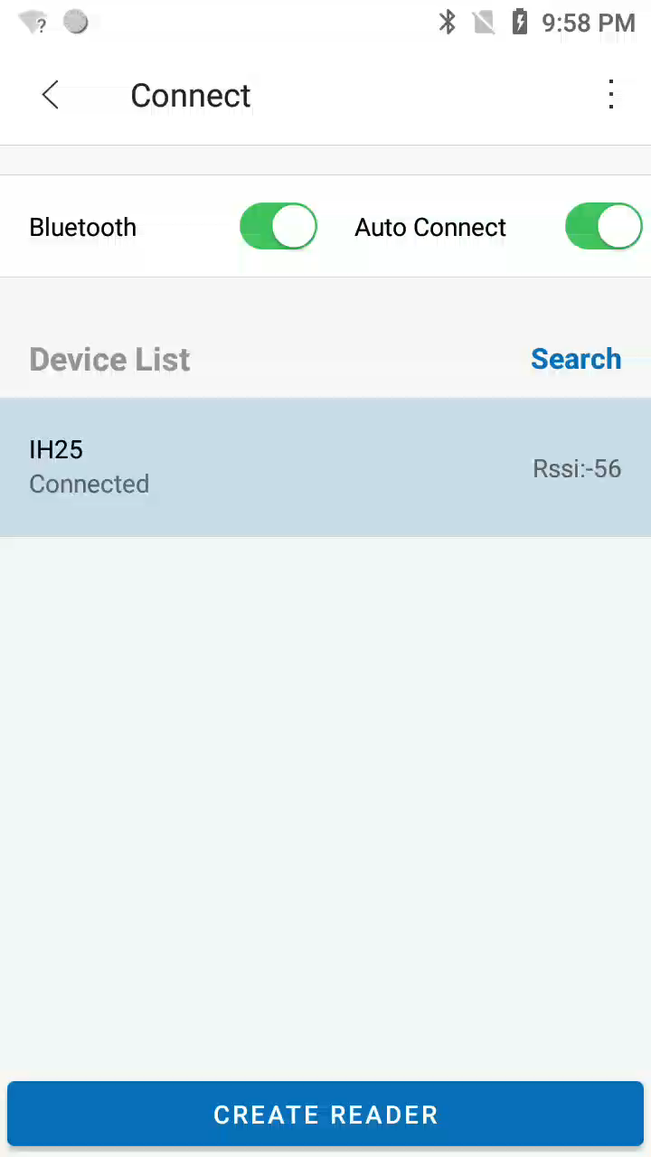
Scan
Reference video
Steps:
1.Go to Connect Page
2.Connect Bluetooth
3.Create Reader
4.Begin Scan
Information
Epc:Electronic Product Code
Cnt:Count
Ant:Antenna
Freq:Frequency
…

Slide 5
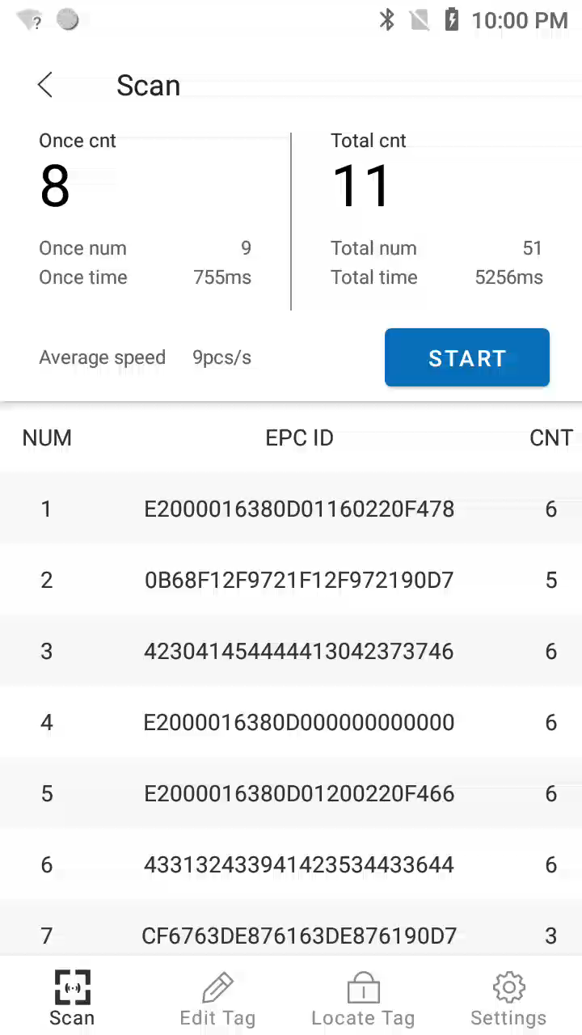
Edit Tag
Reference video
Steps:
1.Choose one Tag in Scan Page
2.Go to Edit Tag Page
3.Start operation

Slide 6
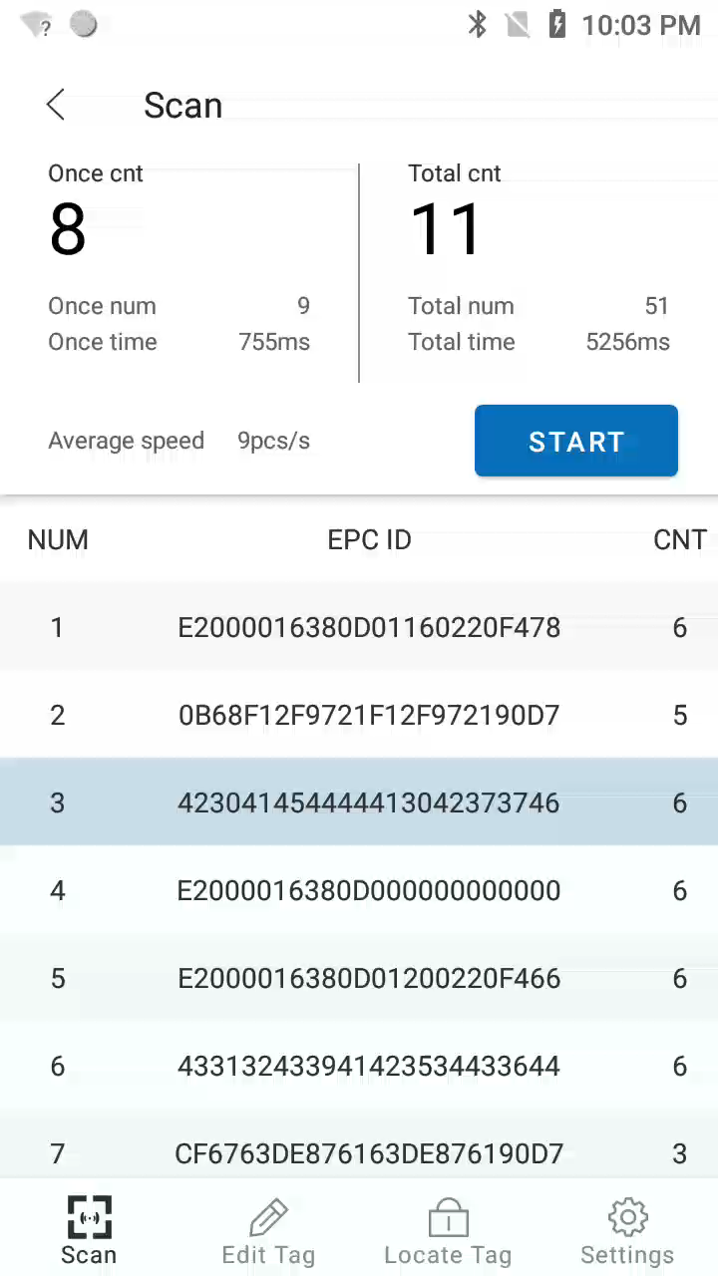
Locate Tag
Reference video
Steps:
1.Go to Locate Tag Page
2.Click Search Icon on ActionBar
3.Input Content to filter Tags
Filter Tags whose epc contains the content you input.

Slide 7
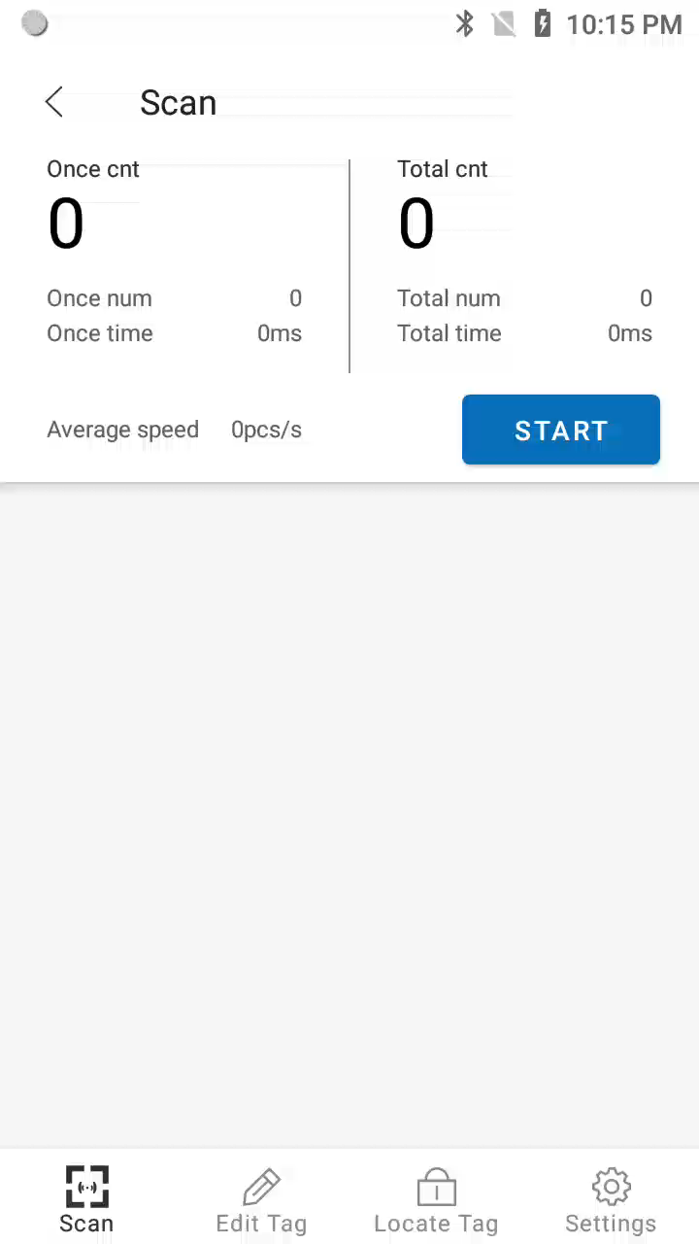
RFID/Engine scan switching
Reference video
Steps:
1.Go to Scan Page
2.Click Switch Button on RFID Handler
3.BccRFID.apk will jump to ScanDemo.apk
4.Hold RFID handler trigger,Engine begin scan
5.Click Switch Button on RFID Handler again
6.Current Page become BccRFID from ScanDemo
7.Hold RFID handler trigger,RFID begin scan

Slide 8

Settings
Reference video
Common Settings:
Single inventory duration
(Only Valid in normal mode)
range:200~2000ms
Single inventory vacancy
(Only Valid in normal mode)
range:200~2000ms
Scan mode
normal mode or fast mode
RFID scanning sound(PDA)
on/off
RFID scanning sound(RFID)
on/off
Antenna Power:
Ant read power
range:5~30dbm
Ant write power
range:5~30dbm
Region Frequency:
Set Region
China---Europe---N/A
View/Set Frequency
Addition:
Addition data type
None/Reserved Bank/Epc Bank/Tid Bank/User Bank
It will take effect in fast mode after you checked data in Return items in Fast Mode Parameters.
Gen2 option:
Session mode
S0:For a small number of Tags
S1:For large number of Tags
S2/S3:For special marked Tags
Fast Mode Parameters:
Pause percentage
range:0%~50%
Return items
count/rssi/ant/frequency/
time/pro/data
Common Attribute:
RFID module temperature
RFID module version
Battery level
Battery temperature
Bluetooth module version

Slide 9
END

